Slide 1


Introduction to database

Slide 2
Team Members.
Jiten Chapagain
Ankit Acharya
Anmol Malla Thakuri
Satindra Bahadur Khadka

Slide 3
Introduction.
This system was created in response to the UPA University's request.
The primary goals of this system are to develop a database model for the UPA University Library Management system, construct that model in accordance with the specifications, and describe the database system.
To address the different business issues, it was essential to employ the previous system, which was a file-based system. With a lot of teamwork and study, this system was effectively developed.
This system includes the systematic documenting of research in several fields: Business rules must be listed in a library together with the necessary entities, characteristics, and relationships between them.
An entity relationship diagram (ERD) must then be normalized before being finished. Finally, MySQL was used to establish the database schema and several tables.

Slide 4
File based management system.
Disadvantages of file-based management system.
Accessibility.
Data duplication.
Inconsistency.
Security problem.
Limited data sharing.

Slide 5
Database and Database management system.
Advantage of database management system.
Reduce Data Redundancy.
Data Sharing.
Data Security.
Backup And Recovery.
Data Consistency.

Slide 6
Business rule and Normalization.

Slide 7
Business rule.
Absolute silence.
Place books where you found them.
Maximum of 5 books can be borrowed at a time.
Cell-Phones must be muted or set to silence.
Books must be returned on time.

Slide 8
Normalization. Un Normalized Form (UNF).
Student Name | Student_ID | Department | Department_ID | Teacher | T_phone
Ram | NP001 | CSIT | DP010 | Tika | 9803214565
Sita | NP002 | Education | DP045 | Sona | 9866754623, 9874561230
Gita | NP004 | Engineering | DP018 | Deepak | 9847678923
Hari | NP003 | Economics | DP007 | Mina | 9806154321, 9876543210

Slide 9
First Normalized Form.
Student Name | Student_ID | Department | Department_ID | Teacher | T_phone
Ram | NP001 | CSIT | DP010 | Tika | 9803214565
Sita | NP002 | Education | DP045 | Sona | 9866754623
Sita | NP002 | Education | DP045 | Sona | 9866754623
Gita | NP004 | Engineering | DP018 | Deepak | 9847678923
Hari | NP003 | Economics | DP007 | Mina | 9806154321
Hari | NP003 | Economics | DP007 | Mina | 9806154321

Slide 10
Conversion to 2NF.

Slide 11
Second Normalized Form (2NF). Partial Dependency.
Student Name | Student_ID | Department | Department_ID | Teacher | T_phone
Ram | NP001 | CSIT | DP010 | Tika | 9803214565
Sita | NP002 | Education | DP045 | Sona | 9866754623
Sita | NP002 | Education | DP045 | Sona | 9866754623
Gita | NP004 | Engineering | DP018 | Deepak | 9847678923
Hari | NP003 | Economics | DP007 | Mina | 9806154321
Hari | NP003 | Economics | DP007 | Mina | 9806154321

Slide 12
Department information table.
Department | Department_ID | Teacher | T_phone
CSIT | DP010 | Tika | 9803214565
Education | DP045 | Sona | 9866754623
Education | DP045 | Sona | 9874561230
Engineering | DP018 | Deepak | 9847678923
Economics | DP007 | Mina | 9806154321
Economics | DP007 | Mina | 9876543210
Student_ID | Department_ID
NP001 | DP010
NP002 | DP045
NP003 | DP018
NP004 | DP007
Student information table.
Student Name | Student_ID
Ram | NP001
Sita | NP002
Hari | NP003
Gita | NP004

Slide 13
Conversion To Third Normalized Form (3NF).

Slide 14
Third Normalized Form (3NF). Transitive Dependency.
Department | Department_ID | Teacher | T_phone
CSIT | DP010 | Tika | 9803214565
Education | DP045 | Sona | 9866754623
Education | DP045 | Sona | 9874561230
Engineering | DP018 | Deepak | 9847678923
Economics | DP007 | Mina | 9806154321
Economics | DP007 | Mina | 9876543210

Slide 15
Department | Department_ID | Teacher
CSIT | DP010 | Tika
Education | DP045 | Sona
Engineering | DP018 | Deepak
Economics | DP007 | Mina
Student Name | Student_ID
Ram | NP001
Sita | NP002
Hari | NP003
Gita | NP004
Teacher | T_phone
Tika | 9803214565
Sona | 9866754623
Deepak | 9847678923
Mina | 9806154321
Student_ID | Department_ID
NP001 | DP010
NP002 | DP045
NP003 | DP018
NP004 | DP007

Slide 16
Identifying attributes of entities.

Slide 17
Publisher
Publisher ID
Name
Address
Contact
Staff
Staff ID
Staff Name
Staff Address
Staff Phone
Member
Member ID
Member Phone
Member Address
Member Email
Member Name
Staff ID
Student ID
Bill
Bill Number
Member ID
Amount
Date
Fine
Student
Student ID
Student Name
Student Address
Department Name
Phone Number
Member ID
Book
Book ID
Price
Title
Edition
ISBN
Publisher ID
Author ID
Book Status
Category ID
Subject Area
Published Date
Author
Author ID
Author Name
Author add
Author phone
Reports
Reg no.
Book return date
Due date
Issue date
Member ID
Reservation
Reservation ID
Reservation date
Member ID
Book ID
Department
Department ID
Name
Head
Category
C ID
C name

Slide 18
Entity Relationship Diagram (ERD).

Slide 19
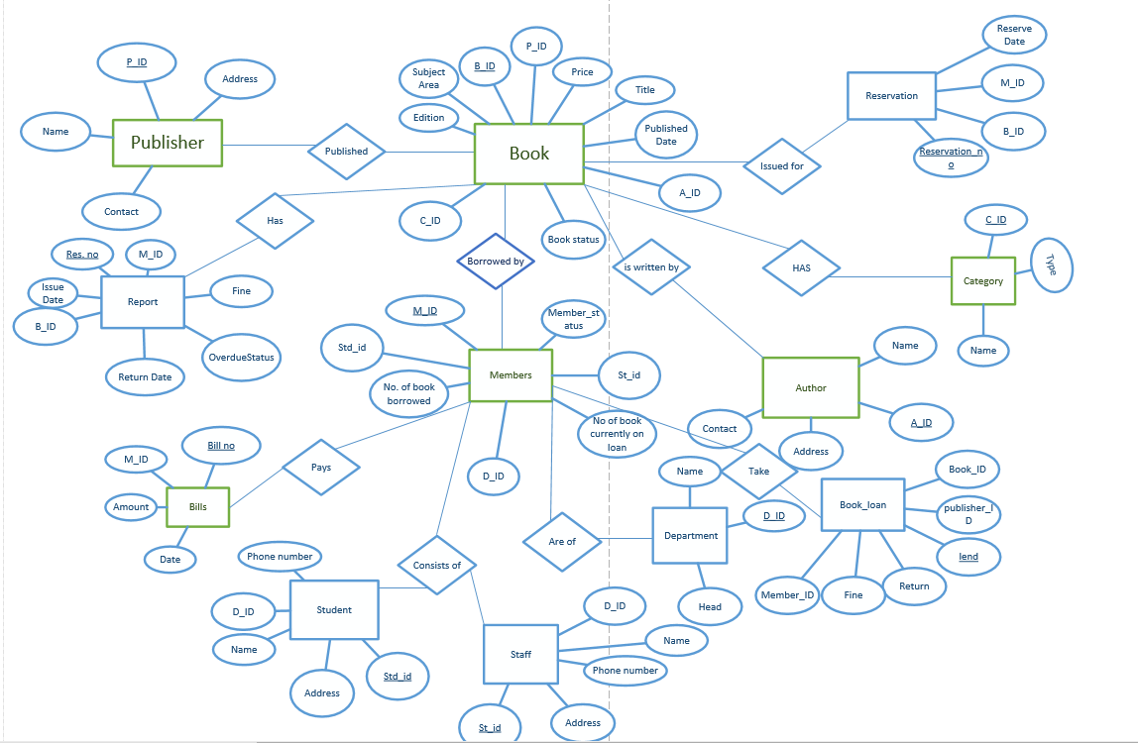

Slide 20
Finalized ERD

Slide 21
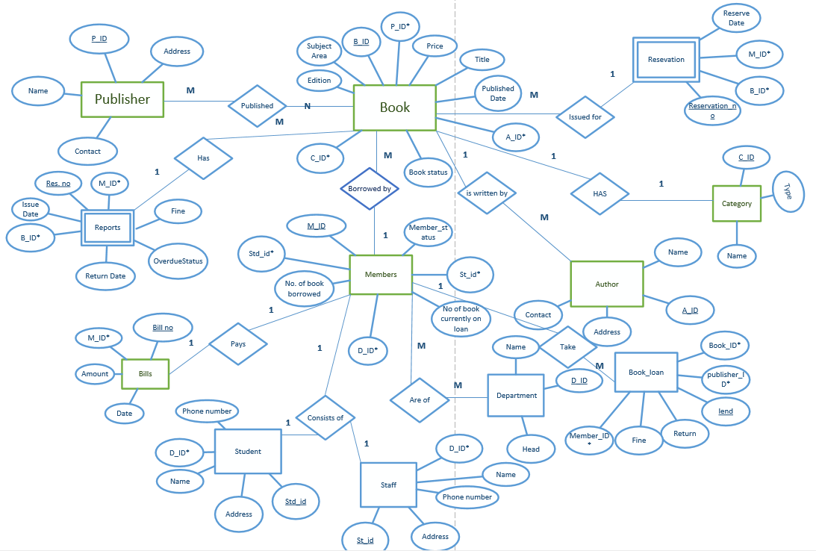
Finalized ERD

Slide 22
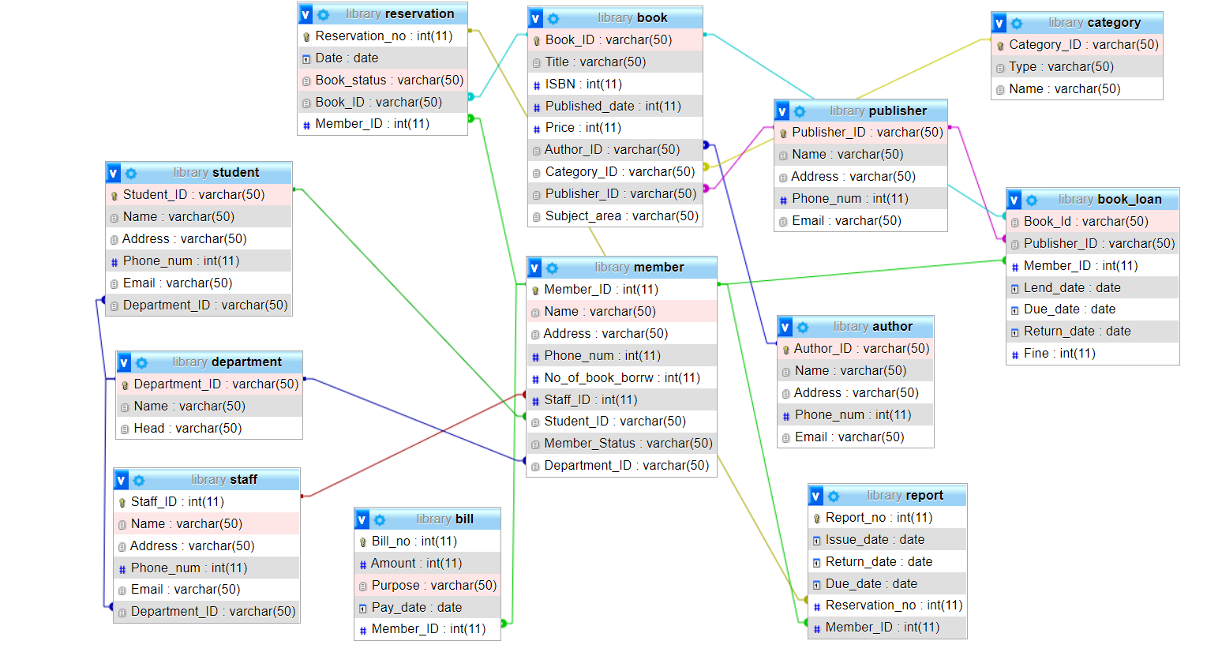

Slide 23
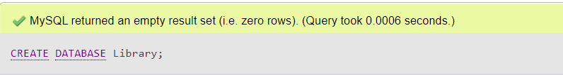
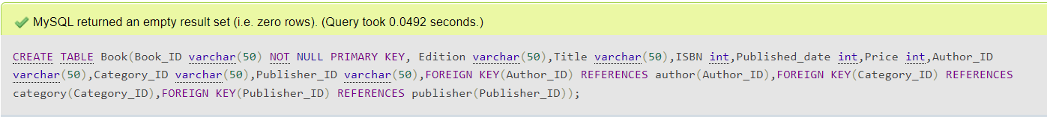
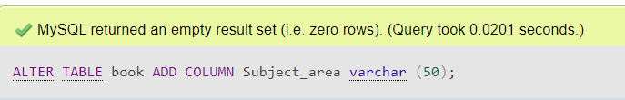
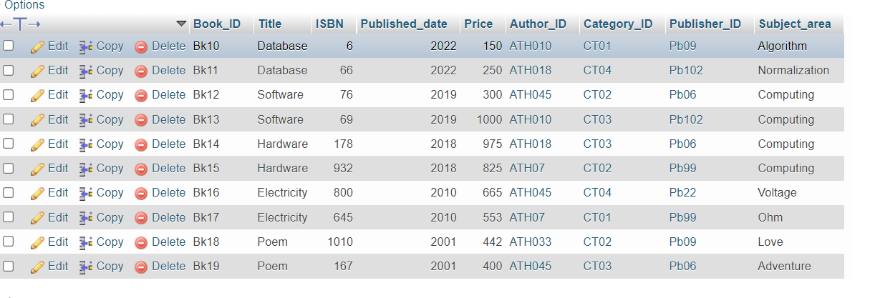
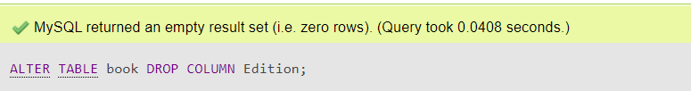
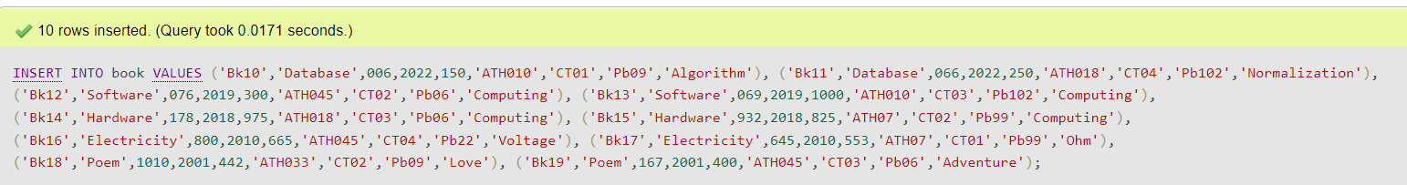
DDL

Slide 24
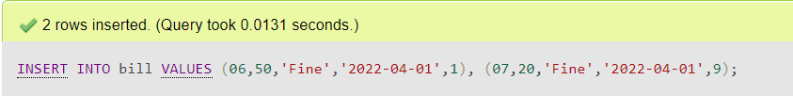
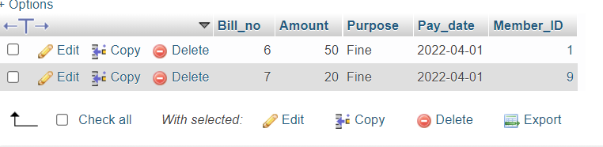
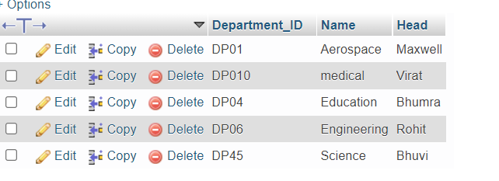
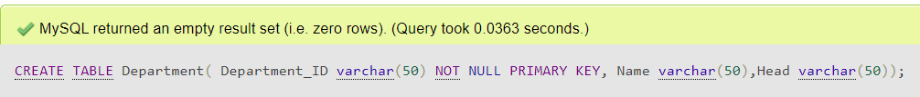
BILL
DEPARTMENT

Slide 25
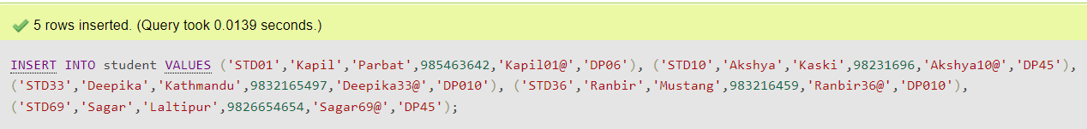
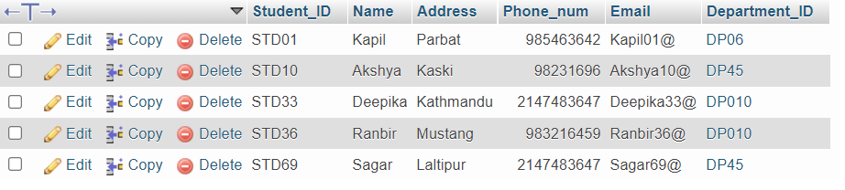
STUDENT

Slide 26
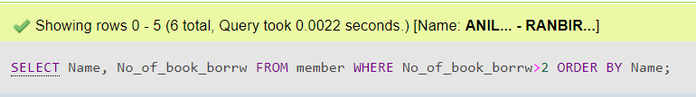
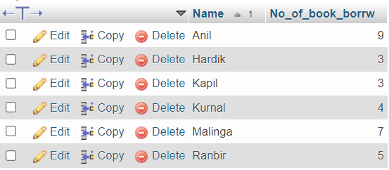
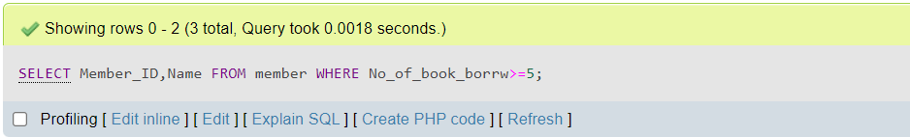
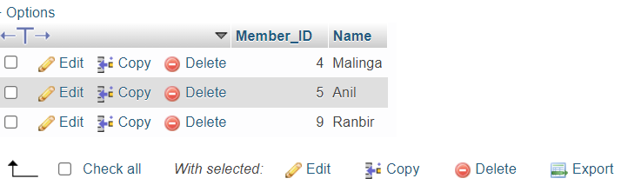
DML
For each member who has borrowed more than 2 books, list the member names and the total number of books currently on loan to them. List the result in alphabetical order of member names.
List the ids and names of all members who have borrowed at least five books.

Slide 27
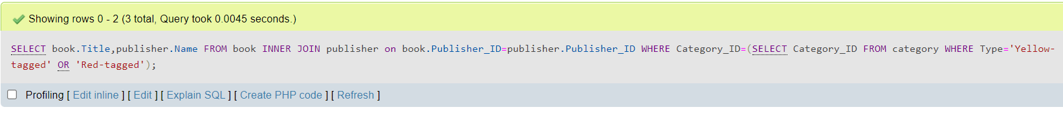
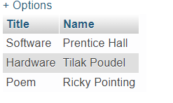

List in alphabetical order, the name of all publisher of book from either the ‘red-tagged’ or ‘yellow-tagged’ categories.
List the member_Id ,member_name book title and the publisher name for all member who had borrowed any book containing the word ‘database’?

Slide 28
workload
Title​ | Anmol​ | Ankit​ | Jiten​ | Satindra​
Database and DBMS​ | 25​ | 25​ | 25​ | 25​
Business Rule and Normalization​ | 25​ | 25​ | 25​ | 25​
Entity Relationship Diagram​ | 25​ | 25​ | 25​ | 25​
Database Schema​ | 25​ | 25​ | 25​ | 25​

Slide 29
Conclusion
At last, I would like to conclude that this project has been a wonderful learning experience to us. We have learned that teamwork is a great factor toward accomplishing a big project with it brainstorming is required form every individual members to come out with a great idea. This project was only possible with the use of different software like Microsoft Visio & xampp.

Slide 30
REFERENCE
Education 4u. (2018, feb 19). Constraint in DBMS [Video]. YouTube. https://www.youtube.com/watch?v=qOlhsLIc0lA
Gate smashers. (2020, December 12). Structure query language [Video]. YouTube. https://www.youtube.com/playlist?list=PLxCzCOWd7aiHqU4HKL7-SITyuSIcD93id
Smart draw. (2018). what is ER diagram? How to make ERD? What are ERD symbols? [Video]. YouTube.
https://youtu.be/dUJp0Yoq5eg
Interview bit. (2022, may26). File System vs DBMS: Know the Difference.https://www.interviewbit.com/blog/file-system-vs-dbms/#:~:text=Advantages%20of%20File%20System,-Following%20are%20the&text=Compactness%3A%20Data%20can%20be%20stored,files%20can%20be%20easily%20edited.
Ullman, A. & Garica.Malina, J. (2017). Data base system (second edition.).
Sibeschatz, A, F. korth, H& Sudarshna.S (2019). Data base system concepts .(7th edition). McGraw-Hill.

